Slide 1

Mastering the Lightning Framework
Part 2 – The programmatic aspects
JF Paradis
Principal Engineer - Salesforce
@jfparadis

Slide 2
Four sections
XML
Section 1: XML Component Definition
JS
Section 3: JS Controller and Helper
Section 2: Styling Components
Section 4: Apex Controller
CSS
Apex

Slide 3
Section 3: JS Controller and Helper
3.1 MVC in Lightning
3.2 JS Controller and Helper
3.3 Events and Methods
3.4 Component Instance Creation

Slide 4
3.1 MVC in Lightning

Slide 5
Overview of MVC
Model–View–Controller (MVC) is a software architectural pattern for implementing user interfaces:
The model, consists of application data, business rules, logic and functions. It’s not only a database.
The view can be any output representation of information, such as a chart or a diagram.
The controller, accepts input and converts it to commands for the model or view.

Slide 6
MVC in single page web apps
Browser:
Backbone, Angular
Server:
Nancy, Spring
View (HTML)
Controller
(JS)
View (REST API)
Controller
(Java)
Model
(JS)
Model
(SQL)

Slide 7
MVC in Lightning
Browser
Server
View (HTML)
Controller
(JS)
Controller
(Apex)
Storage
(JS)
Model
(SQL)

Slide 8
MVC in lightning
Model: persistence
Storage (topic covered in the Apex section)
Component attributes v.something
View: presentation
XML component definition
Controller: logic
JS and Apex Controller

Slide 9
3.2 JS Controller

Slide 10

Example set 10: JS Controller /c/basics301.app

Slide 11
JS Controller
JS file named <component>Controller.js
Auto wired to the component
Inherited when the component is extended
Contains one JS object literal
Members are functions called “actions”
Actions parameter list is usually a tuple:
cmp: the context, the current component
event: if the action was called by an event
helper: a pointer to a component file use for code
Actions usually return nothing (undefined)
No access to this (can’t call an action from an action)

Slide 12
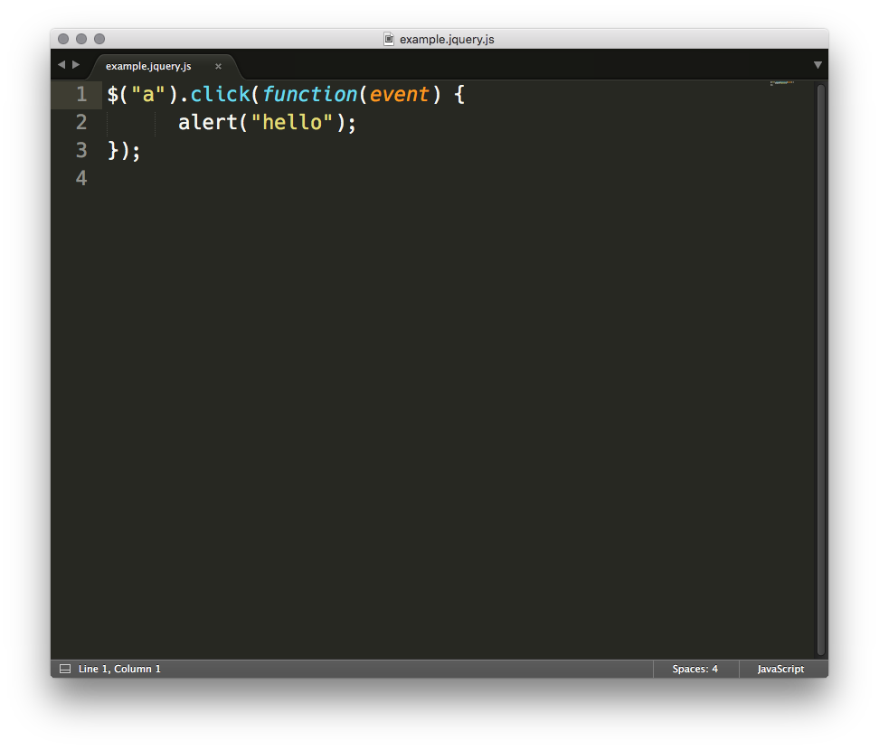
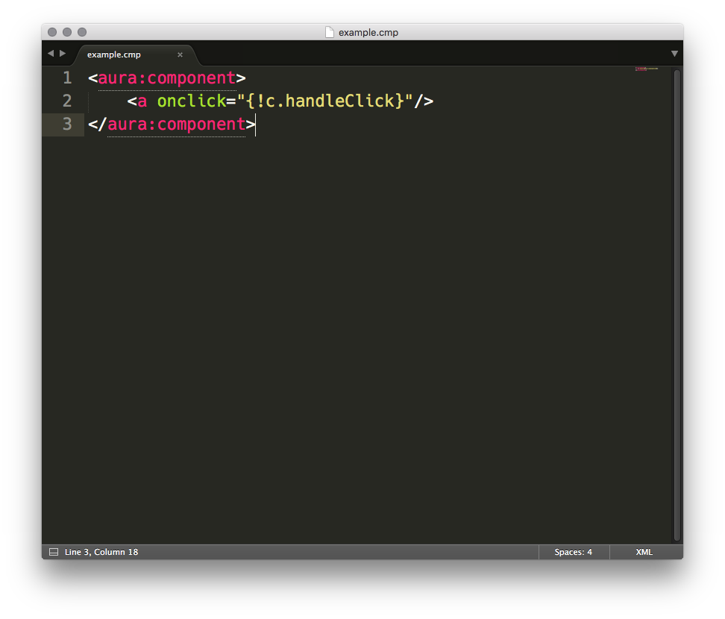
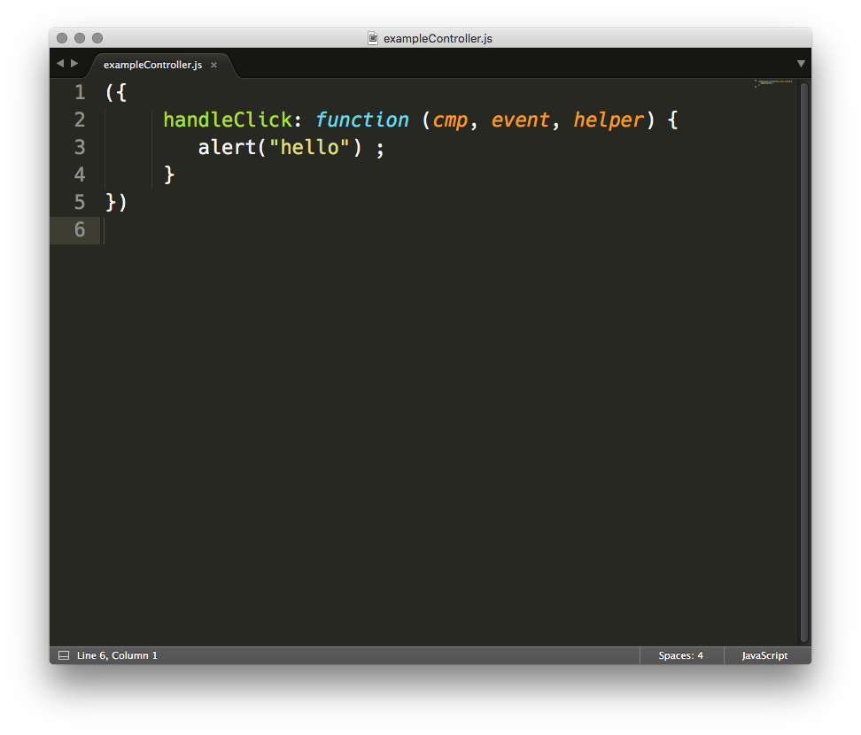
Actions are similar to callbacks

Slide 13
Example set 11: Anchor onclick vs ui:button press /c/basics302.app

Slide 14
Actions can receive two types of events
DOM event
e.g. anchor onclick
event.target: the caller
event.currentTarget: the listener
need to prevent default to indicate you have handled call
Lightning event
e.g. ui:button press of type ui:press
event.source: the caller, e.g. the button component
no need to prevent default to indicate you have handled call
event.getParam(<parameter>)
e.g. event.getParam("domEvent”) returns the original DOM event inside ui:press

Slide 15
Main purposes of controller action
Used as events handlers:
Interaction with a component
e.g. respond to onclick
Change handler
e.g. respond to a value change
Event responder
e.g. component event, global event

Slide 16
Helper
JS file named <component>Helper.js
Auto wired to the component.
One instance per level of inheritance.
Contains one JS object literal.
Members are JS constants, JS functions, JS shared variables.
No restrictions on function parameters and return types.
Helpers are singletons: all components of a given type share the same instance.

Slide 17
Controller ot Helper?
Controller tasks:
“callbacks”
get/set component attributes
respond to events
fire events (other components)
Helper tasks:
code sharing/reuse between controller actions
reduce bloat on the controller
process data
fire events (server, other components)
create testable functions

Slide 18
3.3 Events and Methods

Slide 19
Example set 12: Firing and handling events /c/basics303.app Init and Change Handlers /c/basics304.app Methods /c/basics305.app

Slide 20
Lightning Events
Declared as a bundle, like a component
One XML file named <event>.evt
Can declare attributes
Two types:
Application events: global broadcast, don’t use them (no scope)
Component events: bubble like DOM events
Caution (2016/06, will change):
components events don’t bubble inside component body
they jump to the components that declare the attributes
If you can’t write a component that will be used as a wrapper to catch events in another component (as you can do with DOM events).

Slide 21
Component Init and Attribute Change Handlers
Declared in the component XML:
<aura:handler name="init" value="{!this}" action="<action>"/>
<aura:handler name="change" value="{!v.value}" action="<action>"/>
Typically used to:
Fetch data before a component is created.
Respond to value change with equations not possible in expression language.

Slide 22
Component Methods
Public interface for controller actions
Declared in the component XML:
<aura:method name="<name>" action="<action>"/>
Assign a public name, point to a private controller action
Can declare attributes like events
Parameters passed through the event attribute of the action:
doAction : function(cmp, event) { var params = event.getParam('arguments'); }
Invoked as a function on the component:
component.<name>(arguments…);

Slide 23
3.4 Creating Component Instances

Slide 24
Dynamically Creating Components
Two methods:
$A.createComponent(type, attributes, callback);
$A.createComponents( [{type, attributes}…], callback);
Definitions fetched asynchronously from the server.

Slide 25
Section 4: Using Apex
4.1 Apex Controller
4.2 Action Service

Slide 26
4.1 Apex Controller

Slide 27
Apex Controller: definition
On the server side:
Apex Class - Singleton
Instance methods are “actions” annotated with @AuraEnabled
Not part of the component bundle
Return value auto serialized as JSON
On the client side:
Wired using attribute controller="<class>"
Accessed with cmp.get("c.<action>")
Response in action.getReturnValue()
Return value is a JS object

Slide 28
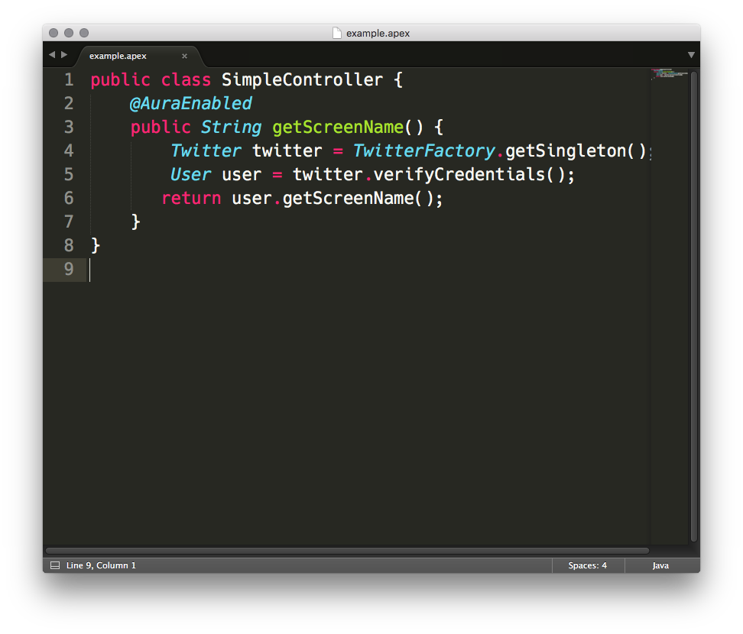
Apex Controller: example

Slide 29
Example set 13: Apex Controller /c/basics401.app

Slide 30
4.2 Action Service

Slide 31
Lightning Action Service
A framework to invoke client- and server-side logic
Emphasis on performance
Multiple actions are multiplexed in a single XHR
Emphasis on security
Constraints on target hosts via CSP
Ensures component can only talk to its controller
Mobile-centric caching
Support offline
Use cached value then async update cache + caller

Slide 32
Action control flow
Foreground
Default
Batched
To reduce number of requests
Background
Sent individually
For long server-side execution
Storable
Result cached
To reduce repeated calls for the same data
Abortable
Canceled if same action triggered again before completion
To avoid multiple results

Slide 33
Lightning event cycle
Fire
Lightning uses a stack to keep track of the deferred tasks to process. At the end of a run cycle, all queued actions are executed.
Execute handlers
Queue actions
Execute queued actions

Slide 34
Example set 14: Action Control Flow /c/basics402.app

Slide 35
Action State
NEW: The action was created but is not in progress yet
RUNNING: The action is in progress
SUCCESS: The action executed successfully
ERROR: The server returned an error
INCOMPLETE: The server didn't return a response. The server might be down or the client might be offline.
ABORTED: The action was aborted. You can register a callback for this explicitly.

Slide 36
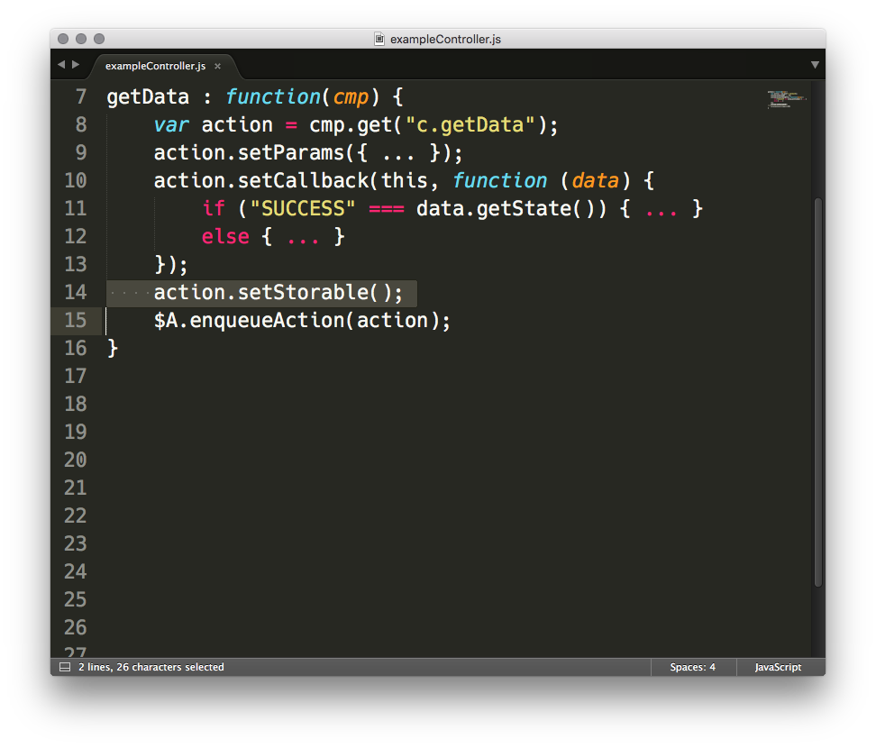
Storable Lightning Actions
For server actions that are idempotent, replayable, and non-mutating
Time-based expiration (15 min in SFX) auto-refresh (30s in SFX)
Re-invoke callback only if refreshed value changes

Slide 37
Storable Lightning Actions
Fire action
Refresh?
yes
Cache hit?
no
yes
no
Update
cache
Different?
Add to cache
yes
no
Action
callback
Action
callback
Action
callback x2

Slide 38
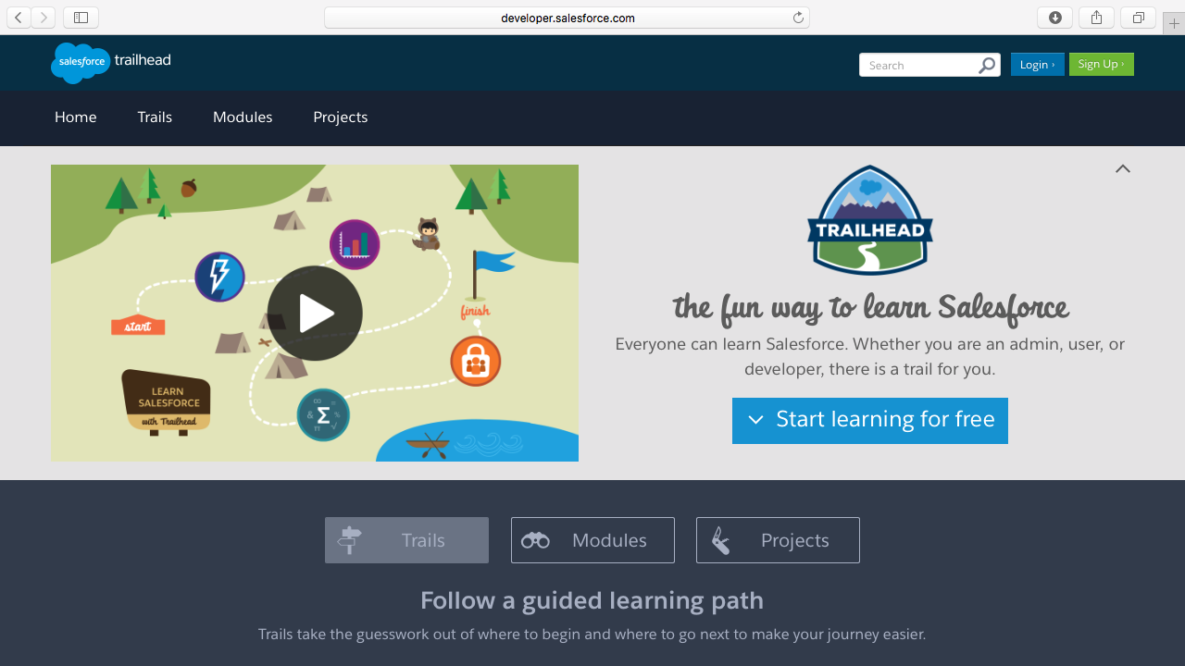
Resources: Trailhead

Slide 39
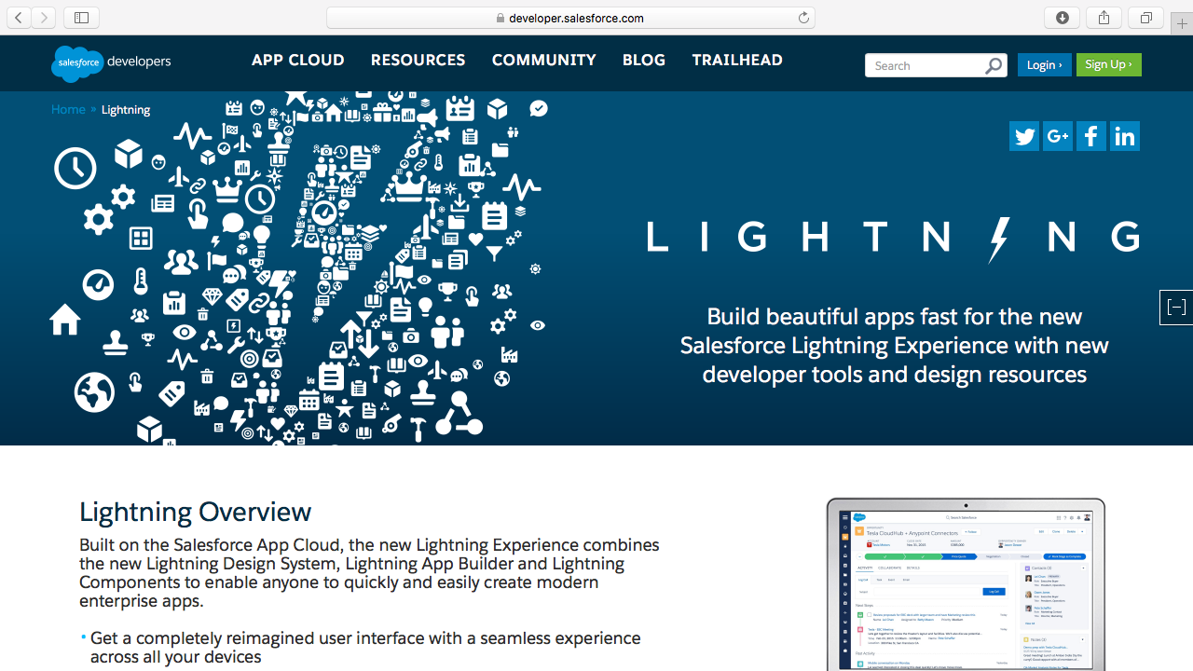
Resources: Lightning section

Slide 40
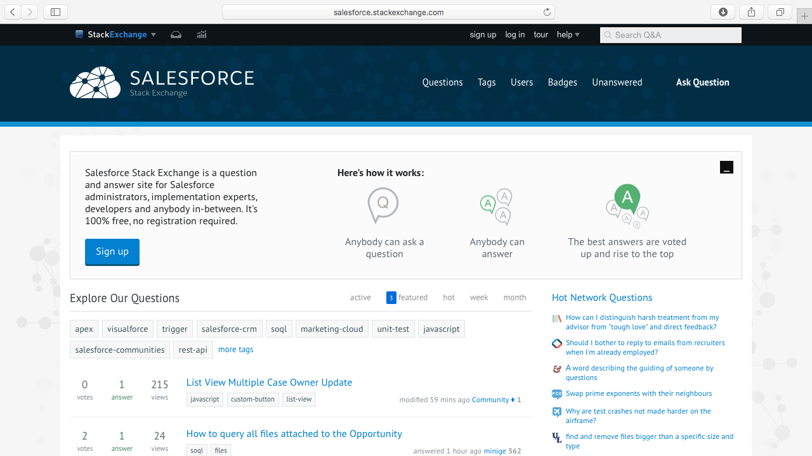
Resources: Lightning section

Slide 41

thank y u

Slide 43
Title Slide
With subtitle
Marc Benioff
CEO
@jfparadis

Slide 44
Secondary Title Slide
With subtitle
Marc Benioff
CEO
@marcbenioff

Slide 45
Title and Subtitle Slide
With logo

Slide 46
Title and Subtitle Slide
Without logo

Slide 47
Title and Subtitle Slide
With logo
And content

Slide 48
Title and Subtitle Slide
Without logo
And content

Slide 49
Customer Title Slide
Title of Customer

Slide 50
Basic Segue Slide

Slide 51
Basic Segue Slide

Slide 52












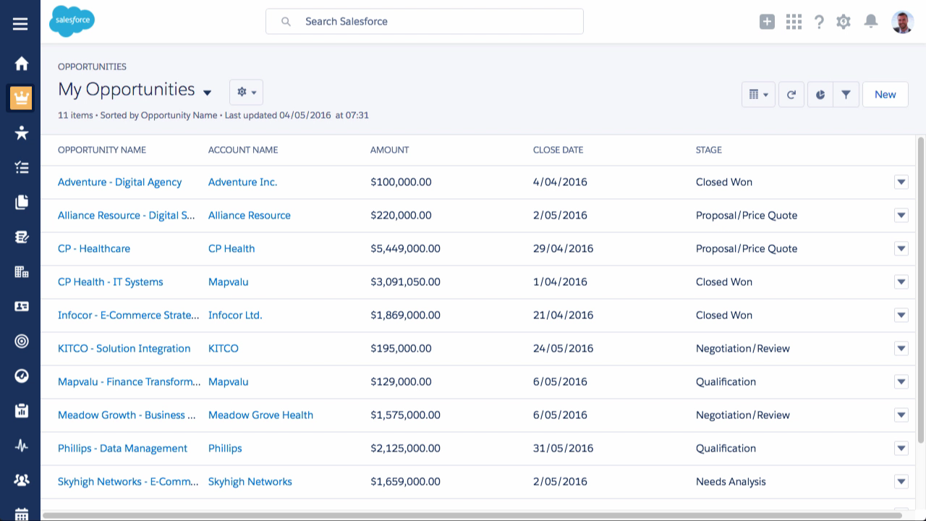

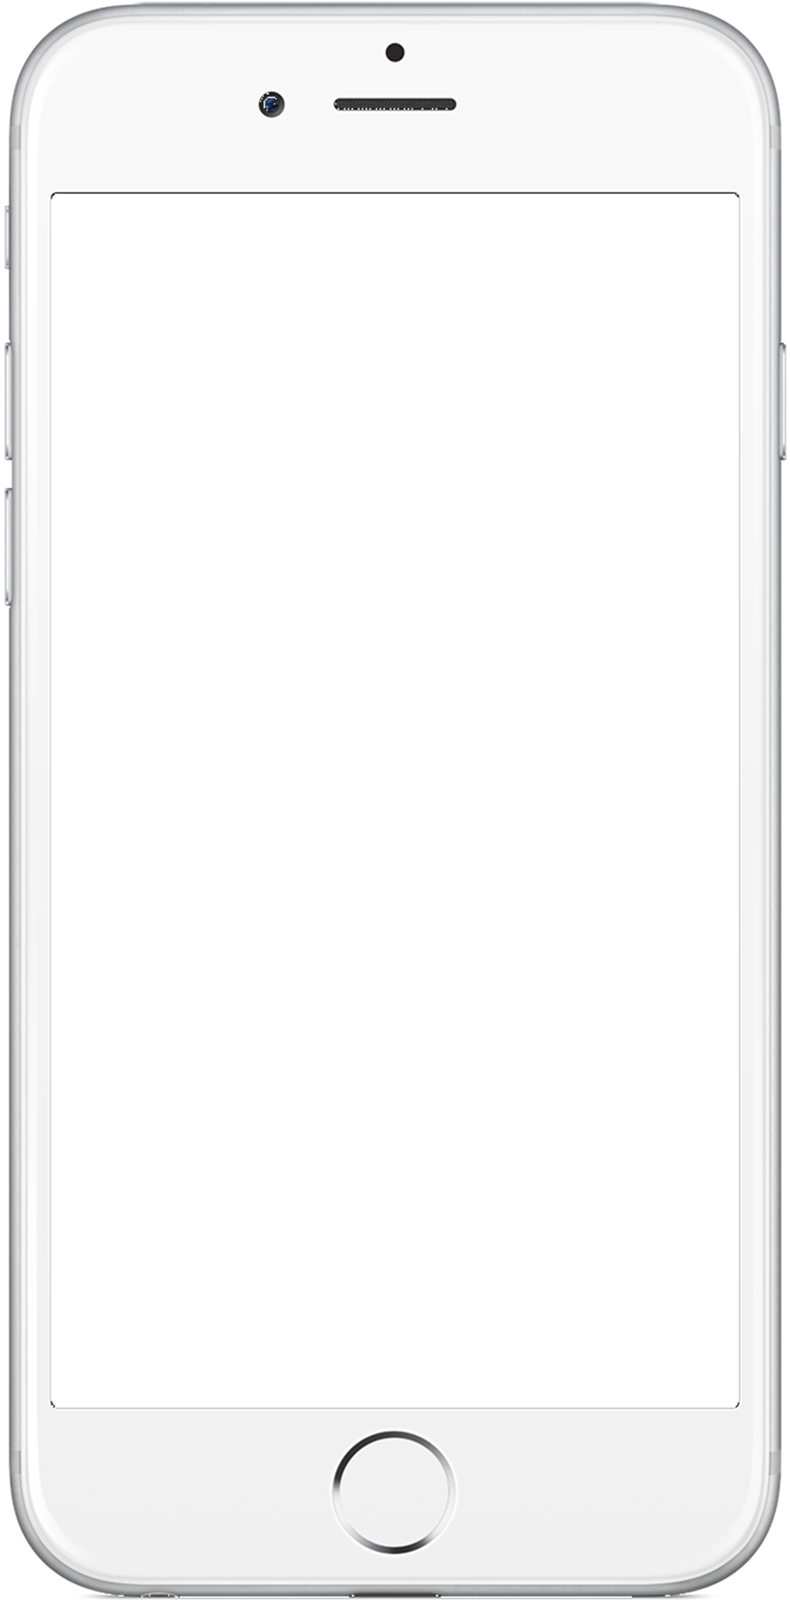
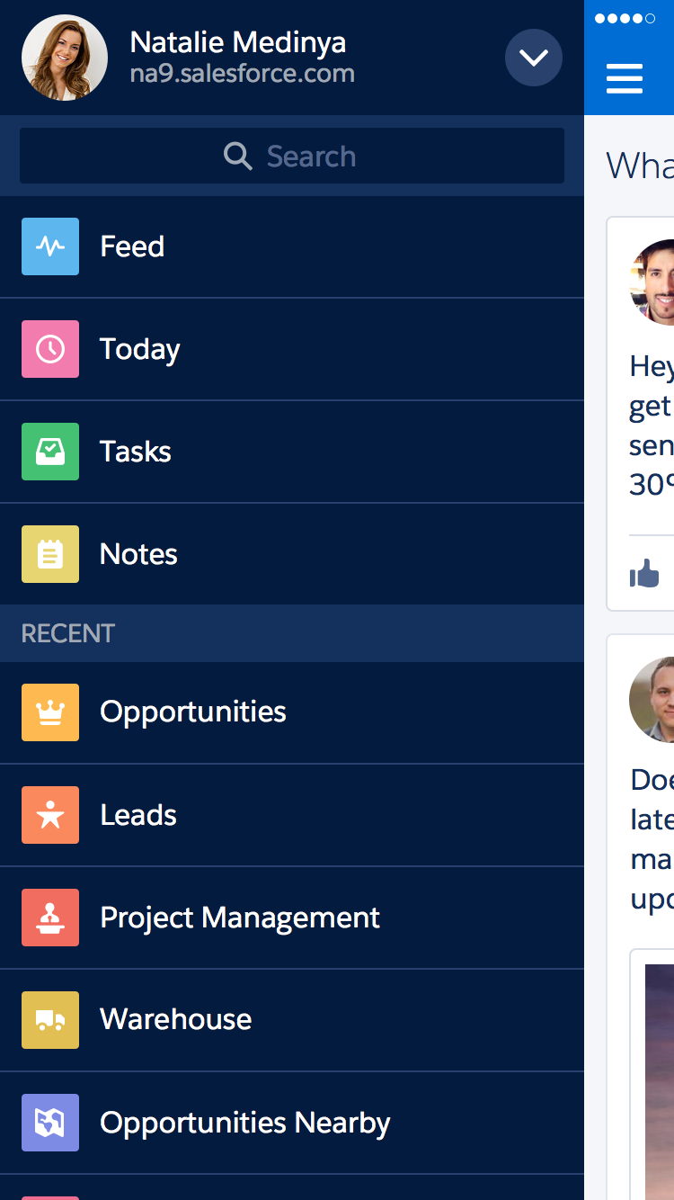
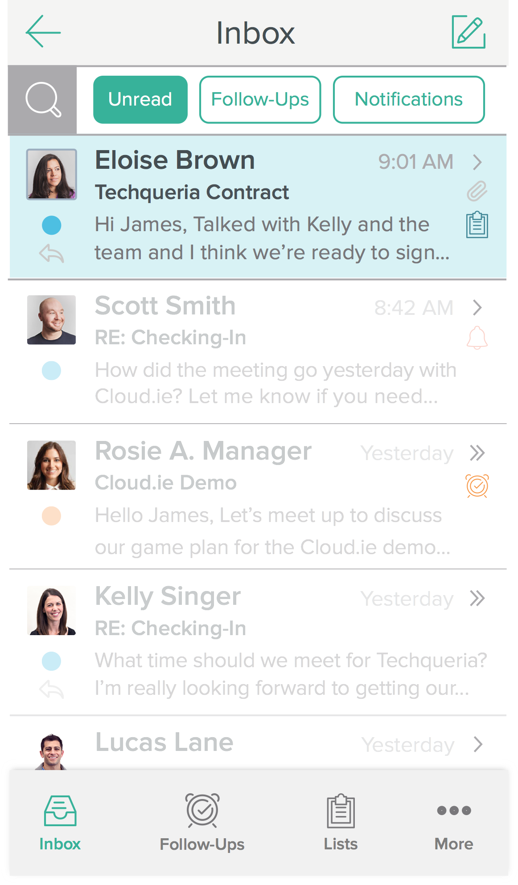
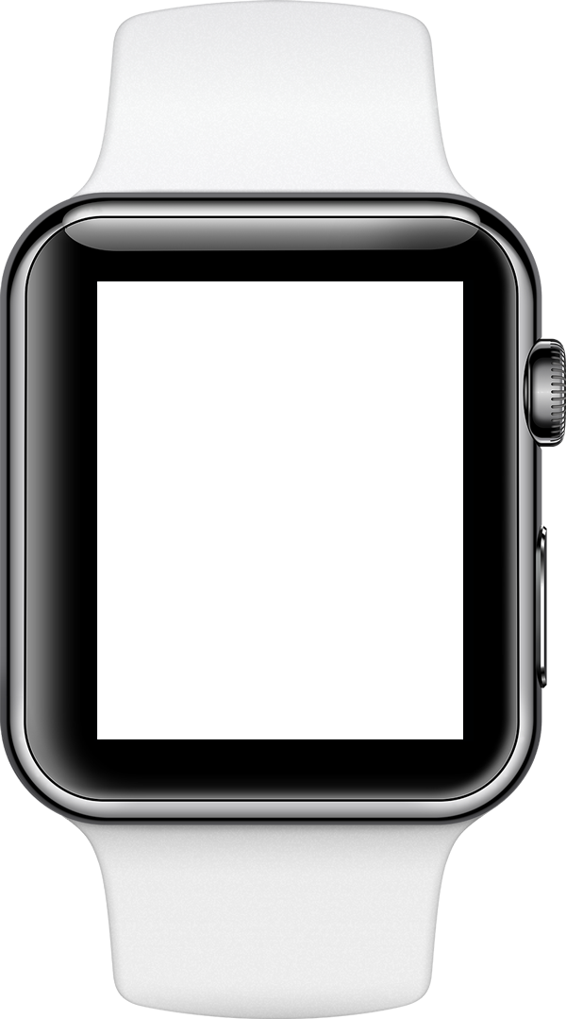
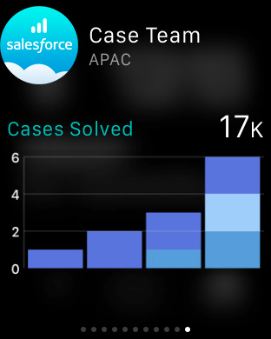

Sales Cloud Lightning
#1 Sales application
Sell the way you want
Lightning Platform & Ecosystem
Sell faster
Salesforce SteelBrick & Microsoft Integrations
Sell smarter
SalesforceIQ & Sales Wave Analytics
Sell from anywhere
Salesforce1 Mobile App
⁺37%
revenue increase
Amy Palan
Partner

Slide 53

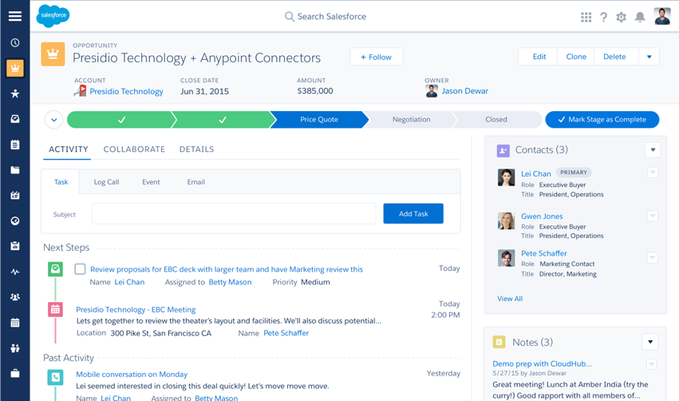
Sales Cloud Lightning
#1 Sales application
Sell the way you want
Lightning Platform & Ecosystem
Sell faster
Salesforce SteelBrick & Microsoft Integrations
Sell smarter
SalesforceIQ & Sales Wave Analytics
Sell from anywhere
Salesforce1 Mobile App
⁺37%
revenue increase

Slide 54
thank y u

